Slide 1
FACE RECOGNITION-AUTHENTICATION
PYTHON CIA-2 PROJECT

Slide 2
GROUP MEMBERS
VENKATSARAN VASIREDDY
AKHILA RAYALA
TEJASWI TATINENI
KRUTHIKA ELESWARAPU

Slide 3
INTRODUCTION
Facial recognition works by identifying and measuring facial features in an image. It can identify human faces in images or videos, determine if the face in two images belongs to the same person, or search for a face among a large collection of existing images.

Slide 4
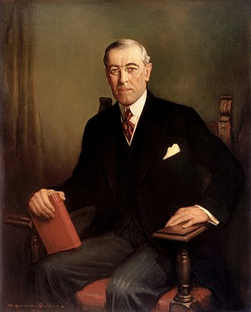
Who introduced facial recognition system?
In 1967, Woodrow W. Bledsoe, a pioneer in artificial intelligence, developed a system that classified photos of faces through a graphical computer input device called a RAND tablet.

Slide 5
Here we are using facial recognition to take attendance
Of a person ,through this process of taking attendance we can ensure that there is no chance for proxy or error.
Name of the person along with date and time is recorded in separate excel sheet.

Slide 6
The process uses a computer application that captures a digital image of an individual's face -- sometimes taken from a video frame -- and compares it with images in a database of stored records.

Slide 7
MODULES INSTALLED
Face Recognition
Open cv
Cmake
dlib

Slide 8
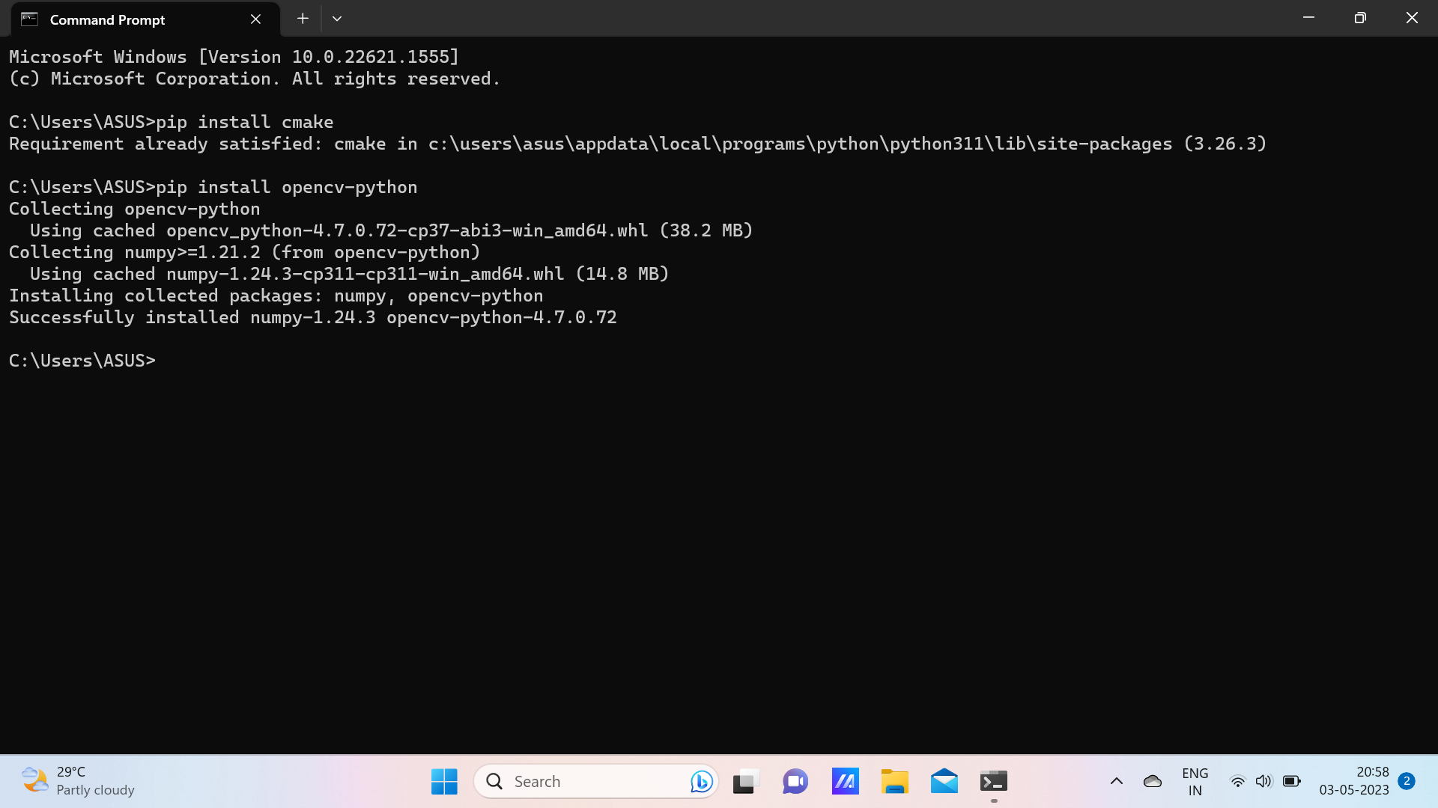
MODULES INSTALLED

Slide 9
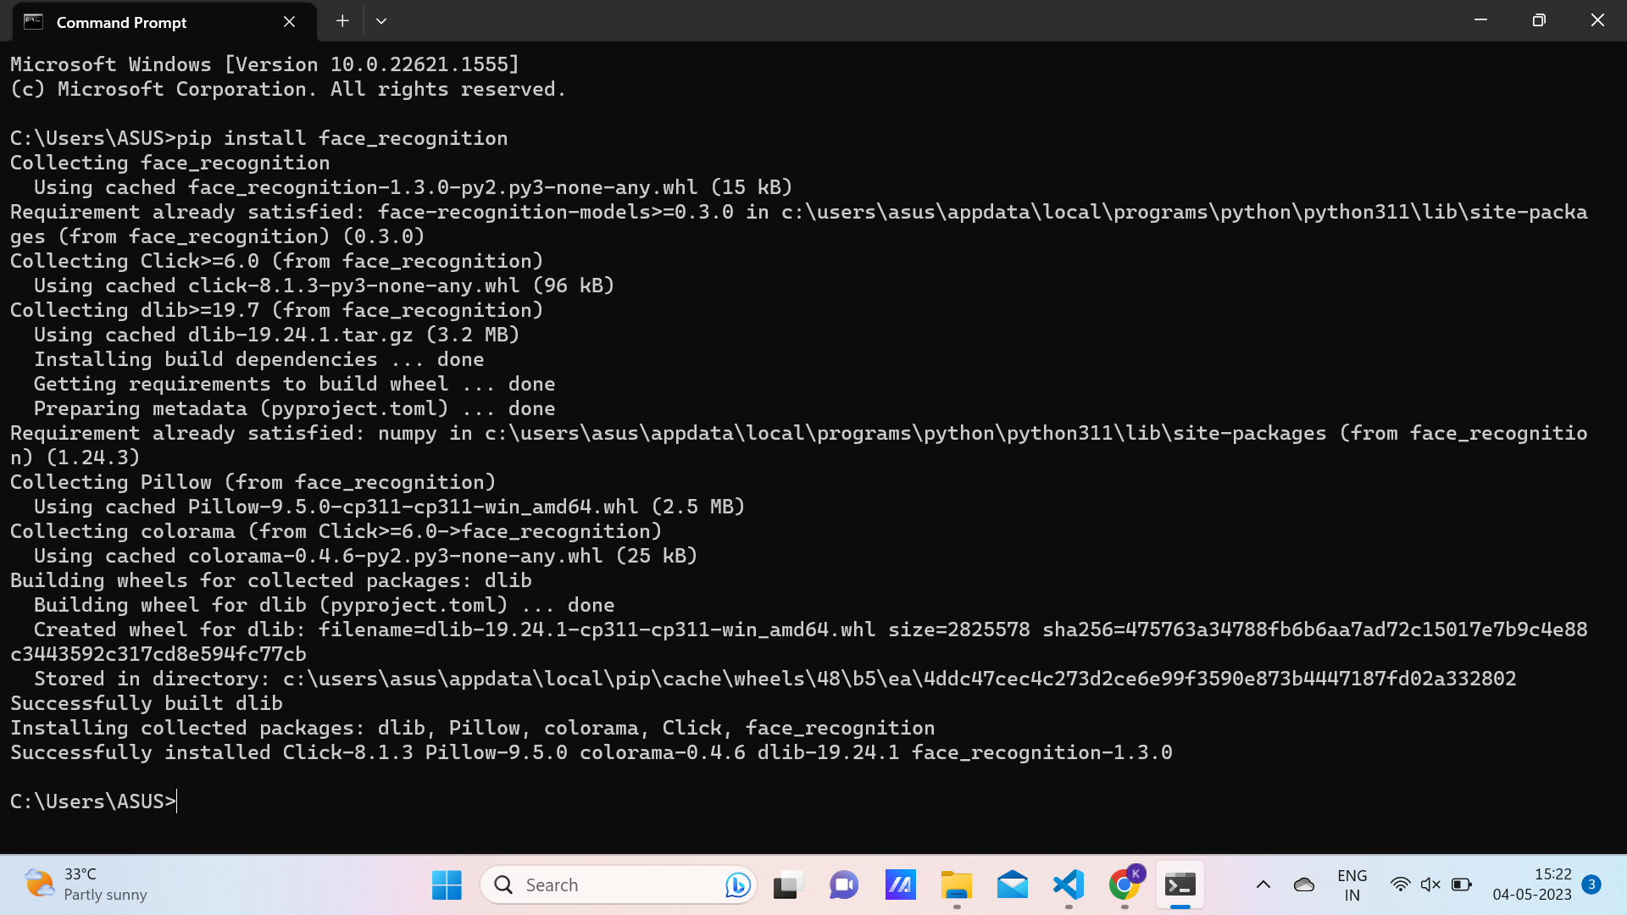
MODULES INSTALLED

Slide 10
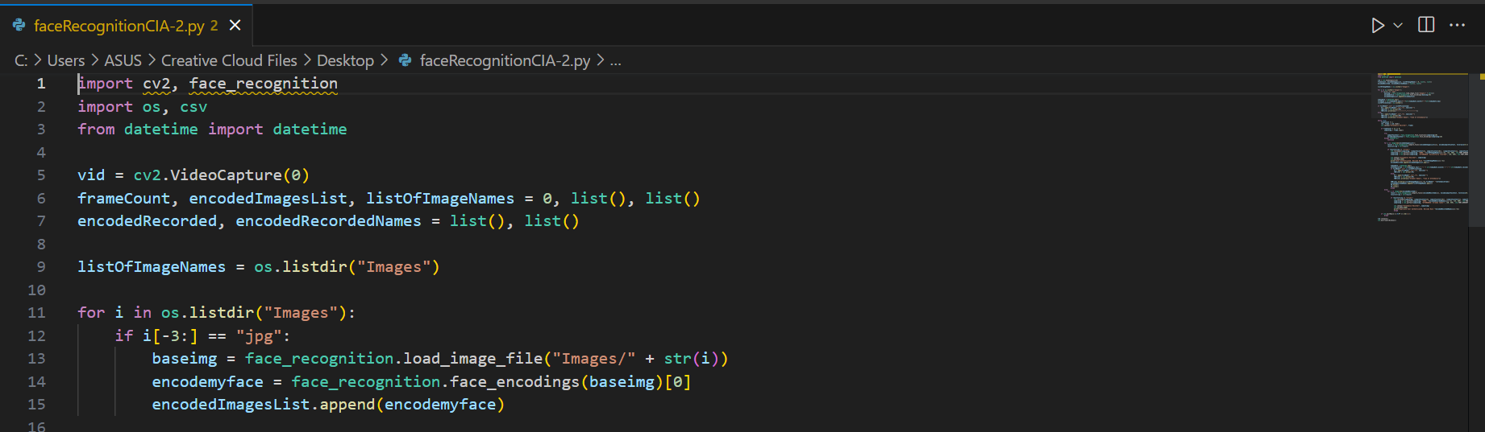
CODE:

Slide 11
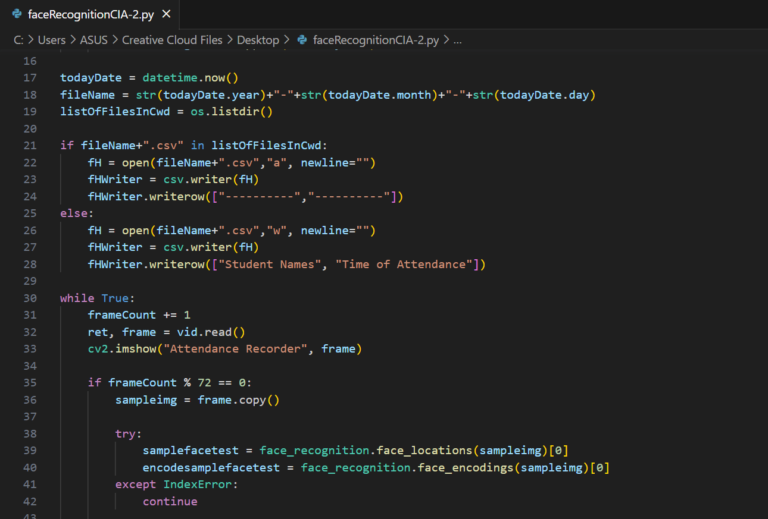

Slide 12
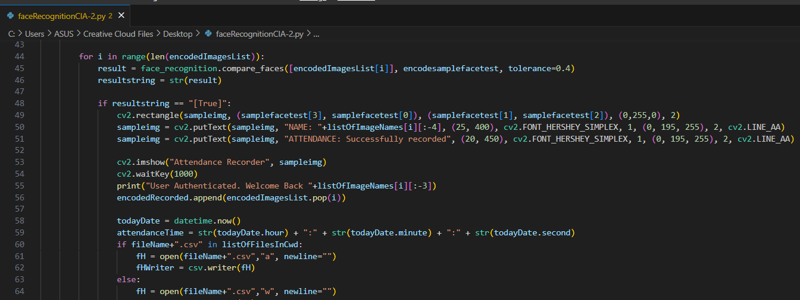

Slide 13
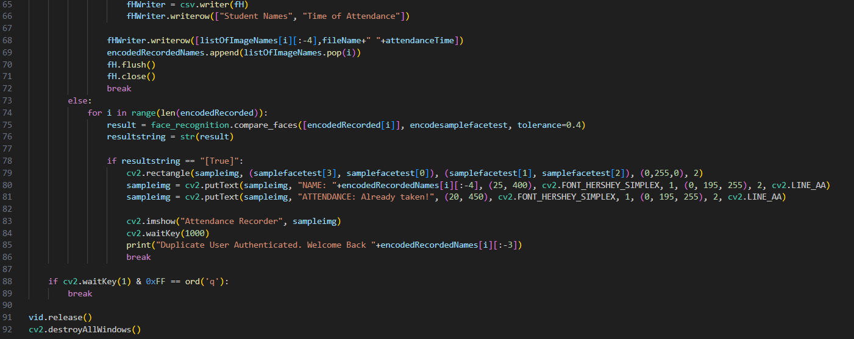

Slide 14
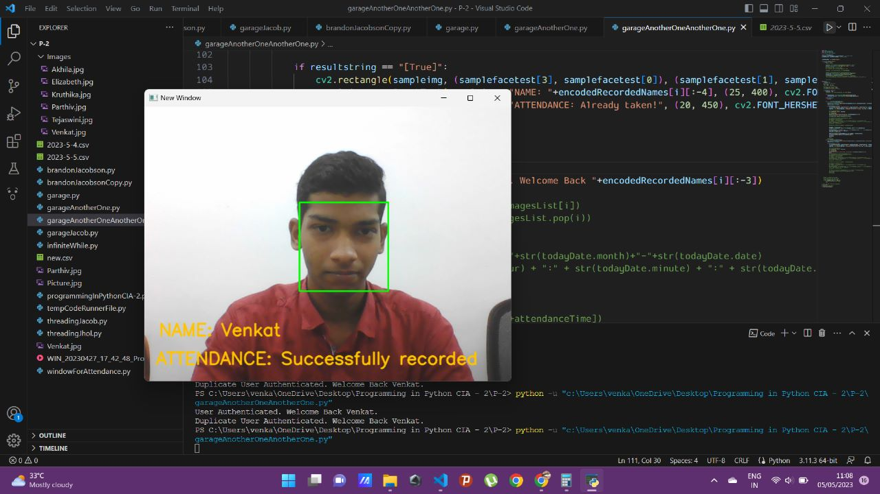
OUTPUT

Slide 15
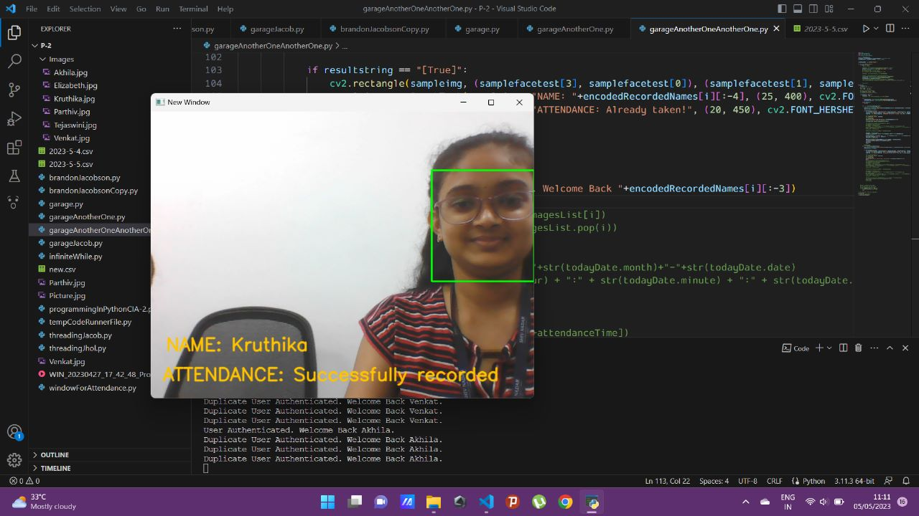

Slide 16
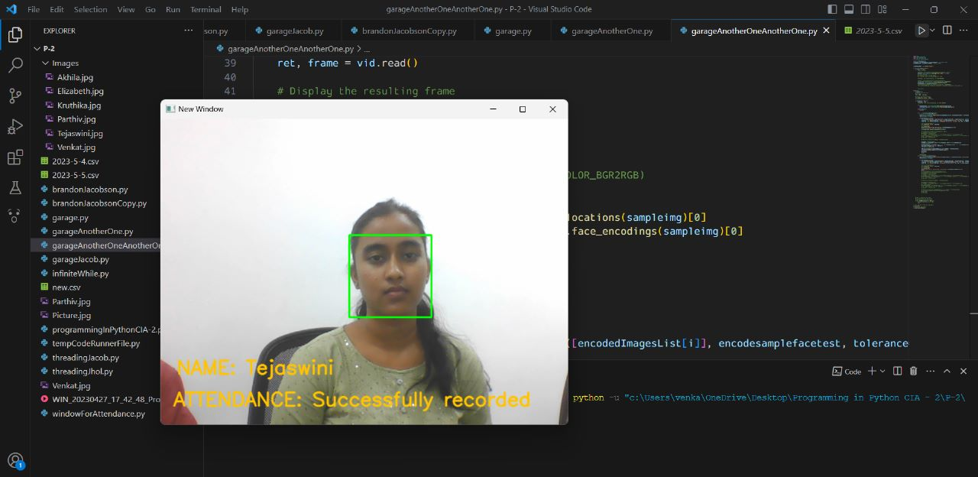

Slide 17
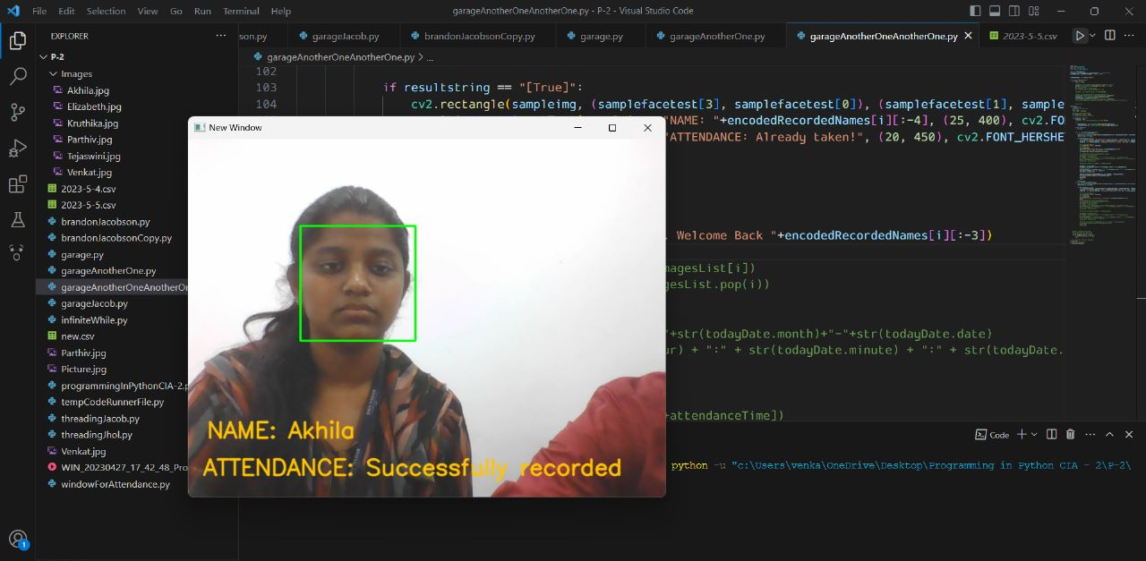

Slide 18
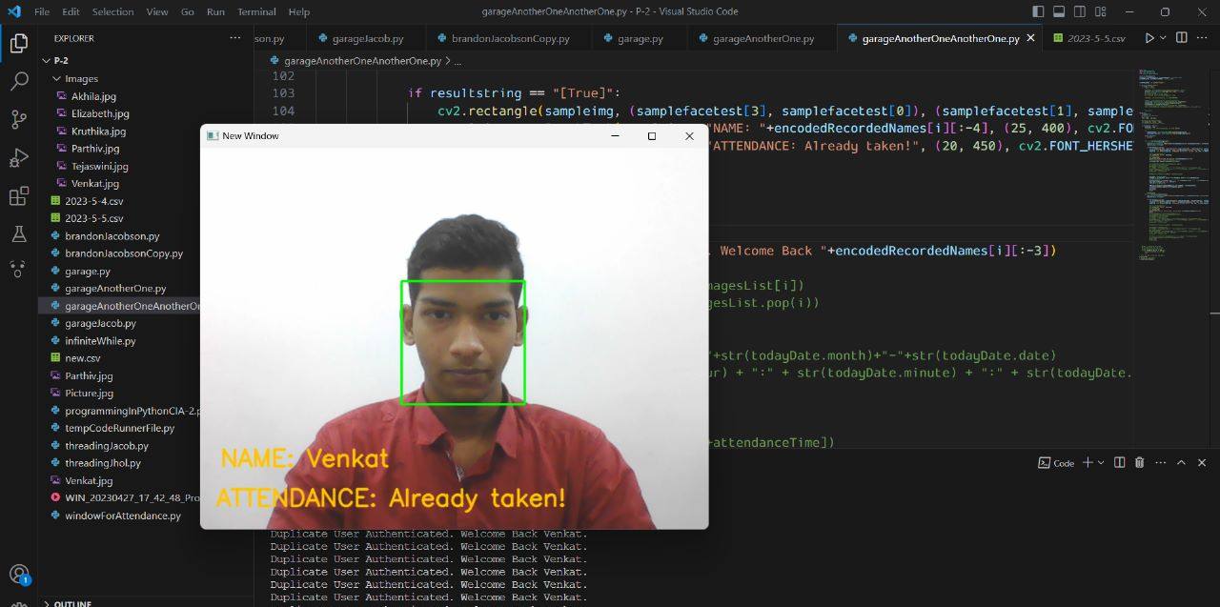

Slide 19
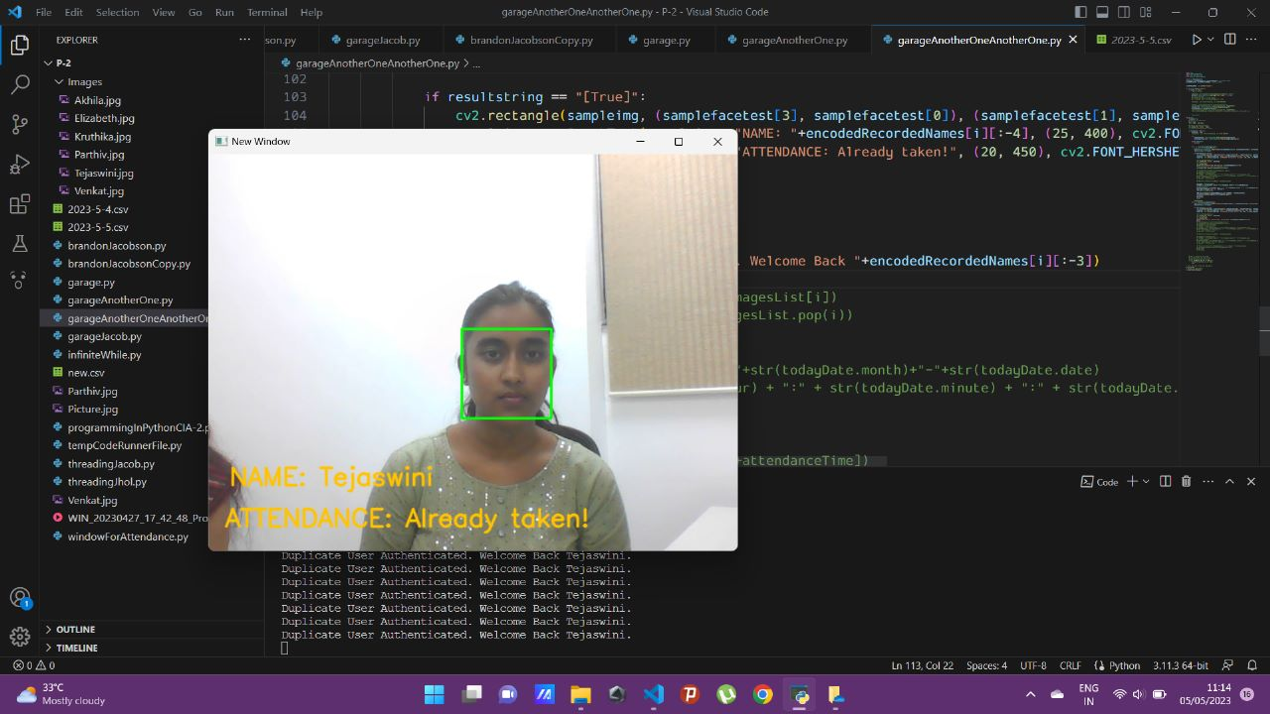

Slide 20


Slide 21
